Slide 1
Notes:
SHERMAN

Slide 3
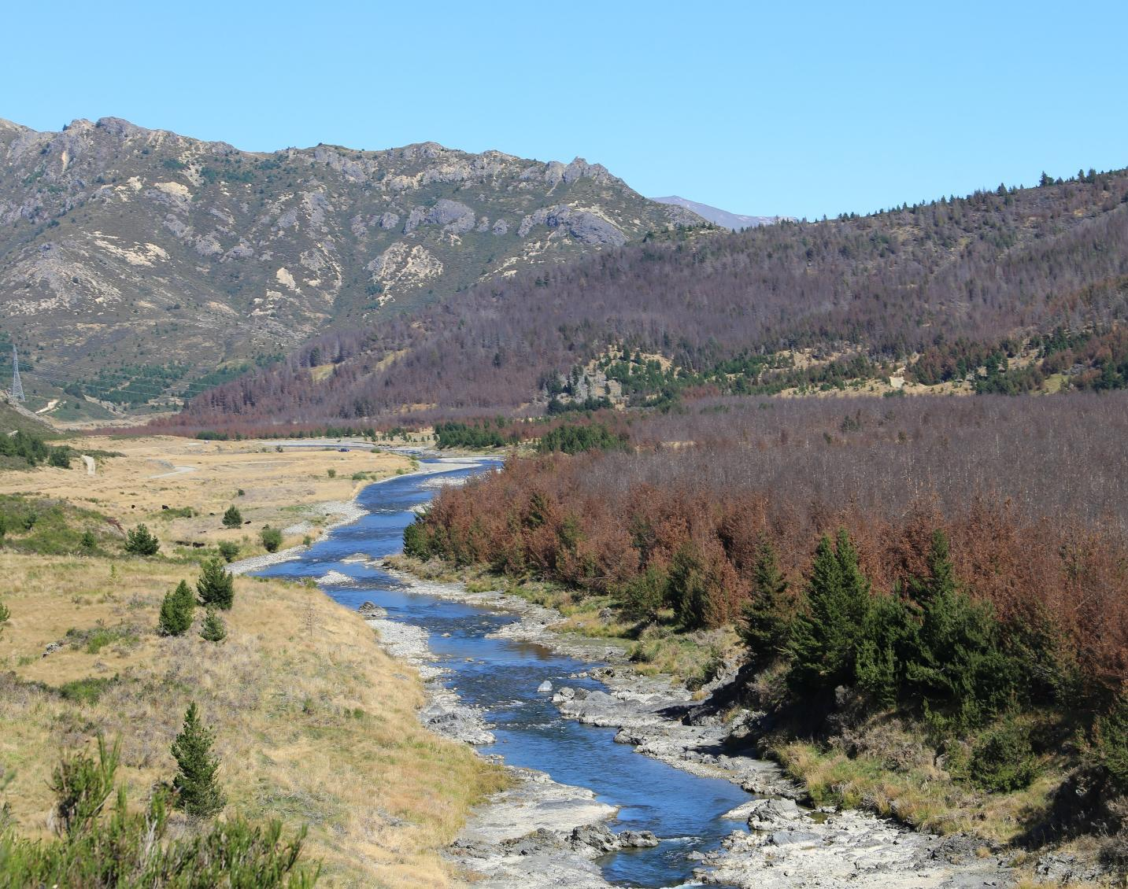
RIGHT CLICK THIS IMAGE TO CHANGE TO A DIFFERENT PHOTO, OR JUST DELETE
(DELETE THIS BOX)
Notes:
Sherman

Slide 4
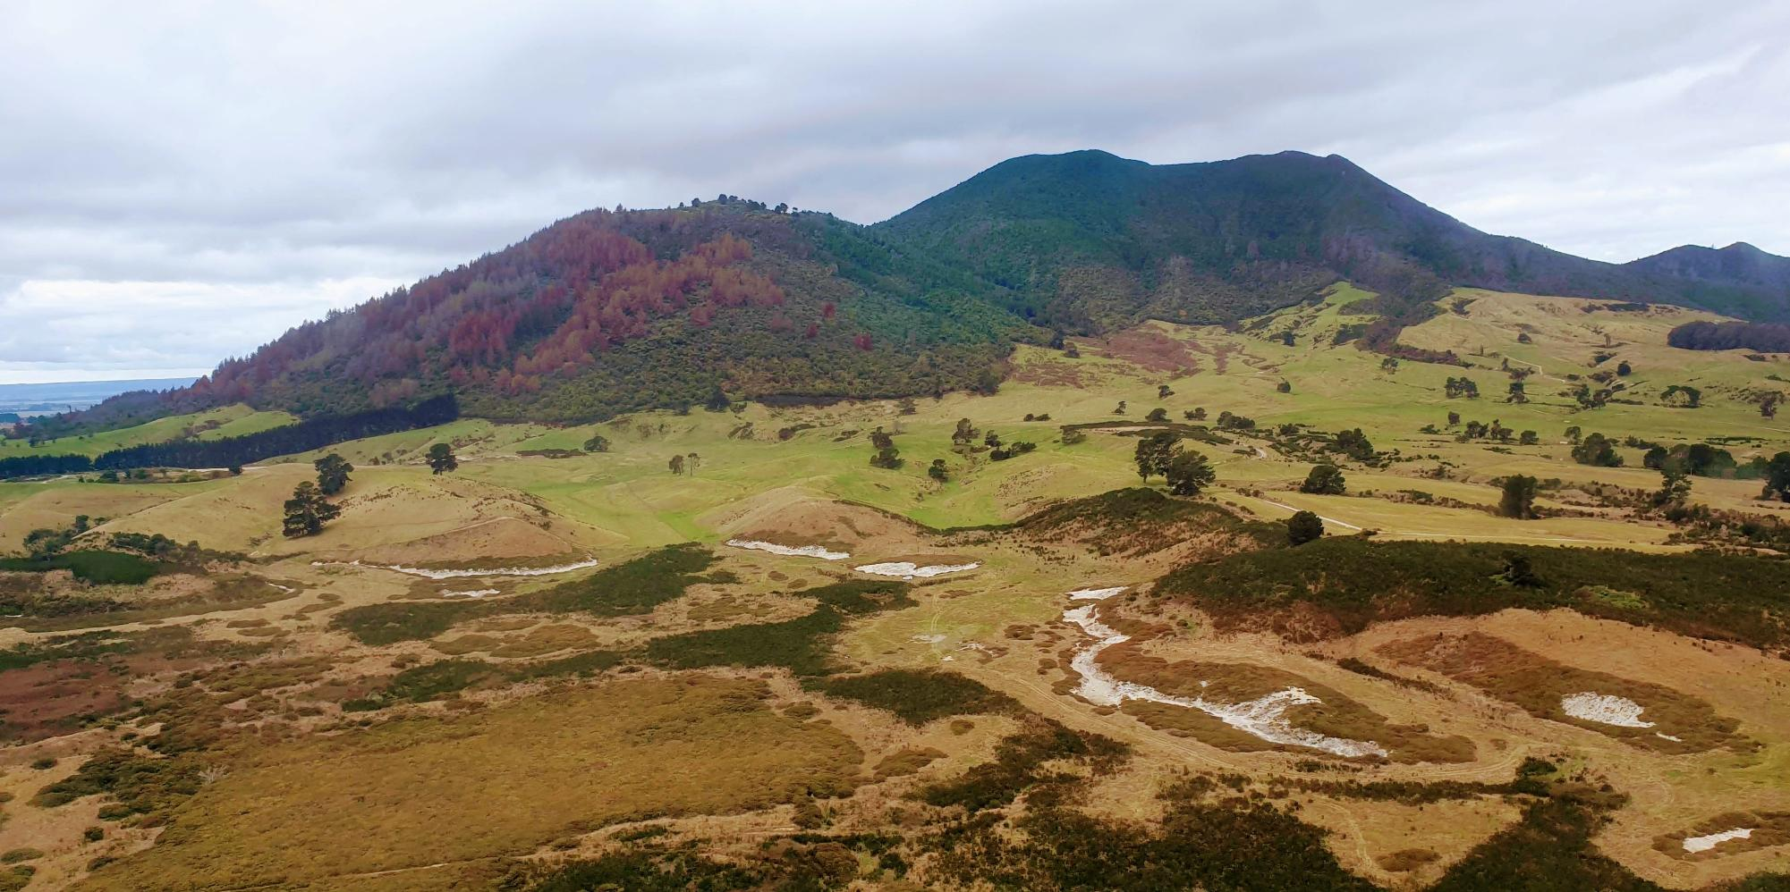
RIGHT CLICK THIS IMAGE TO CHANGE TO A DIFFERENT PHOTO, OR JUST DELETE (DELETE THIS BOX)
Bullet 1
Bullet 2
Notes:
- First point – immediately there are some factors outside the programme’s control that influence the distance to that vision – the vision has not changed but the path has gotten only more winding

Slide 5
Main bullet point (type over this)
Sub points if needed (type over this)
Space for small images / graph - DELETE BOX

Slide 6
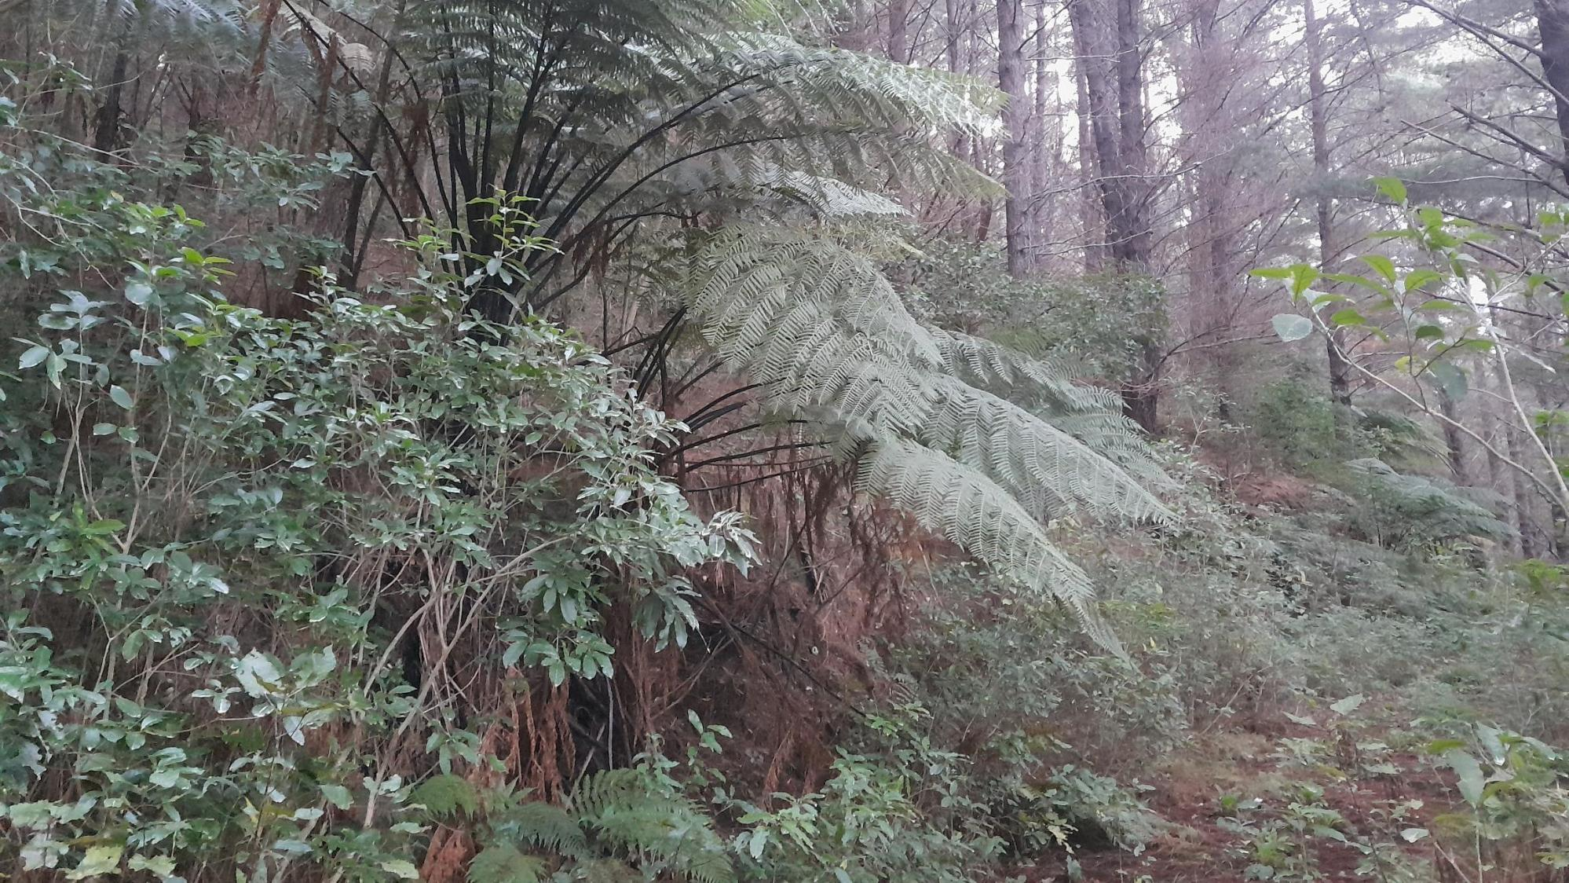
Thank you Questions?
RIGHT CLICK THIS IMAGE TO CHANGE TO A DIFFERENT PHOTO, OR JUST DELETE (DELETE THIS BOX)
Notes:
This photo courtesy of George Shallcrass, Hawke’s Bay, member of the farm Forestry Association.
Showing native regrowth between rotations in a radiata forest.

Slide 7
The following slides hold graphic elements for applying to illustrated slides in the ‘campaign’ style. Copy and paste into your slides and resize as needed. Then delete these slides from your final presentation.

Slide 8













Coloured blocks that can be used behind feature statements (copy, paste and resize as needed – can be stretched any direction)
<Transparent texture block converts any background to texture
URL blocks (copy, paste and resize as needed – keep aspect ratio locked)

Slide 9






Coloured & transparent textures for backgrounds (copy, paste and resize as needed – can be stretched any direction to fill slide)
Transparent creased, recycled (grainy) texture
Transparent recycled texture (grainy, uncreased)
(remove border, just for visibility here!)
Transparent creased texture (no grains)

Slide 10





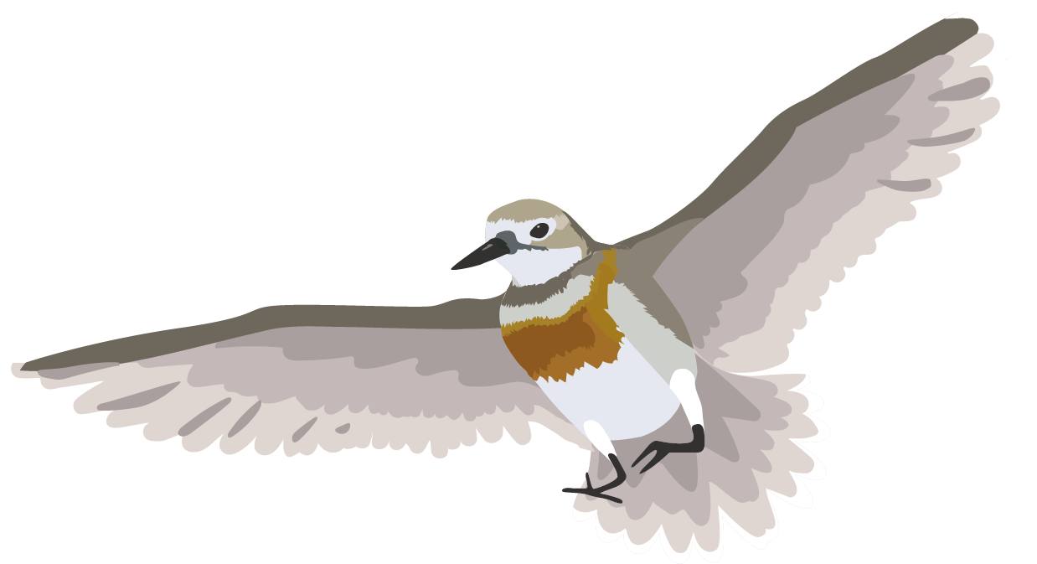
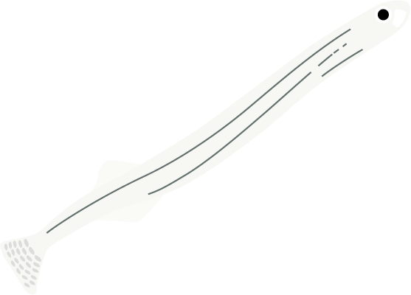





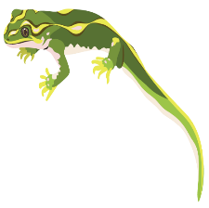
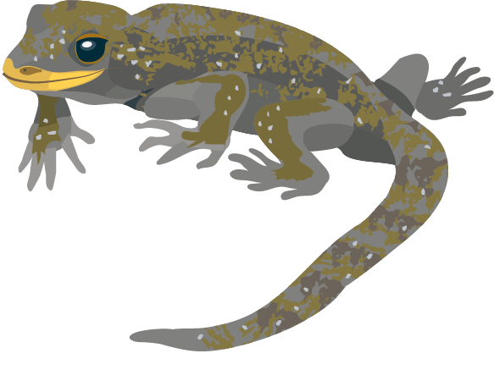
Native wildlife for illustrations
(copy, paste and resize as needed – keep aspect ratio locked (resize only from corners)

Slide 11




Native landscapes for illustration or borders
(copy, paste and resize as needed – keep aspect ratio locked (size only from corners)

Slide 12






Wilding landscapes and individual trees for backgrounds or illustration - can re enlarged to fill whole slide
(copy, paste and resize as needed – keep aspect ratio locked (size only from corners)

Slide 13
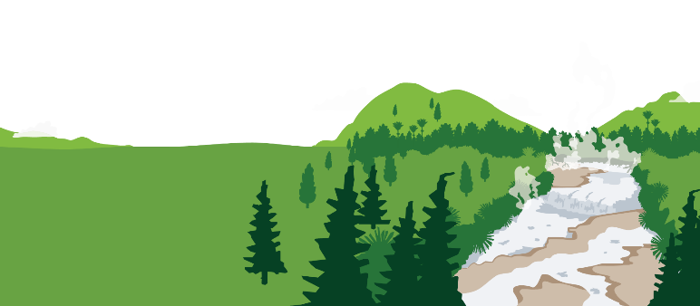
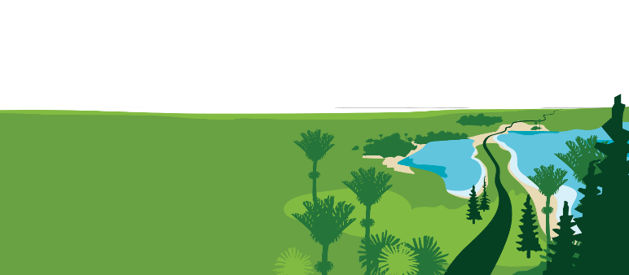
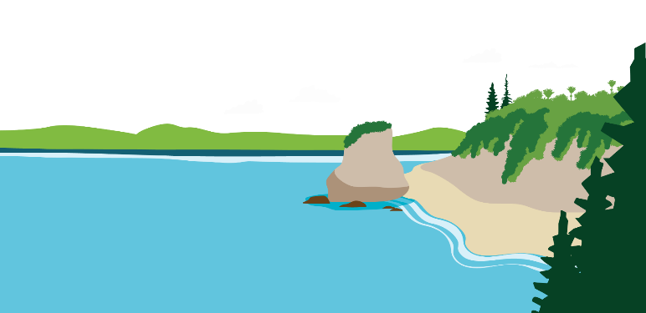



Landscapes for slide base backgrounds
(copy, paste and resize as needed to fill slide width – keep aspect ratio locked (resize only from corners)

